Slide 1
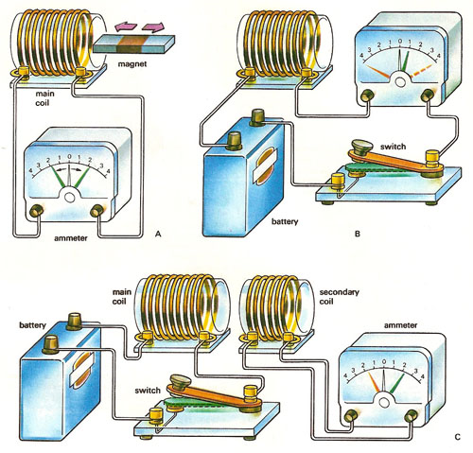
Ch.37.1 Electromagnetic Induction
Faraday and Henry both discover that electric current could be produces in a wire by simply moving a magnetic in or out of a wire coil.
. No battery or other voltage source was needed only the motion of a magnet in a coil or in a single wire loop.
.They discovered that voltage was induces by the relative motion of a wire with respect to a magnetic field.
.It is the relative motion of the coil with respect to the magnetic field that induces voltage. It so happens that any change in the magnetic field around the conductor induces a voltage. This phenomenon of inducing voltage by changing the magnetic field around a conductor is electromagnetic induction

Slide 2
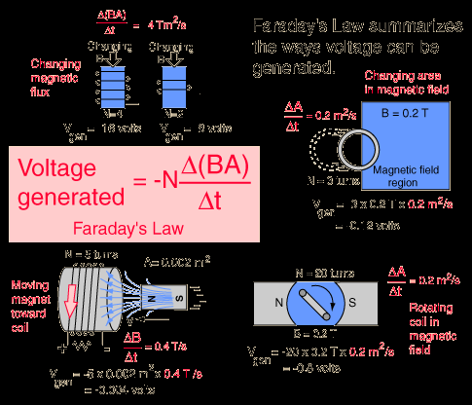
Faraday’s Law
Electromagnetic induction can be summarized in a statement that is called Faraday’s law.
Voltage= (# loops of wire)* (rate of change in magnetic field
Voltage is one thing and current is another.
The amount of current produced by electromagnetic induction depends not only on the induced voltage but also on the resistant of the coil and the circuit to which it is connected.
Example: you can plunge a magnetic in and out of a closed rubber loop and in and out of a

Slide 3
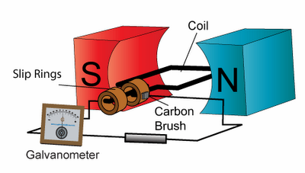
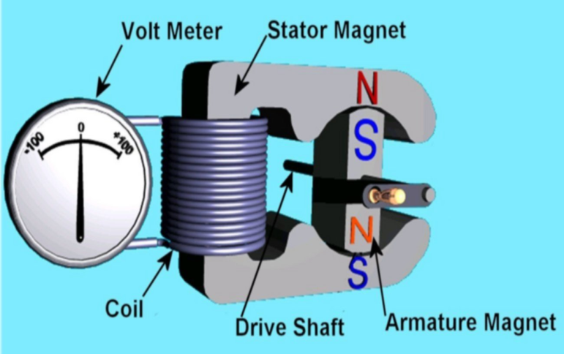
Generators and Alternating Current
If on end of a magnetic is plunged in and out of a coil of wire, the induced voltage alternates is direction. As the magnetic field strength inside the coil is increased (magnet entering), the induced voltage in the coil is direct one way.
Rather than moving the magnet, it is more practical to move the coil. This is best accomplished by rotating the coil in a stationary magnetic field. This arrangement is called generator.

Slide 4
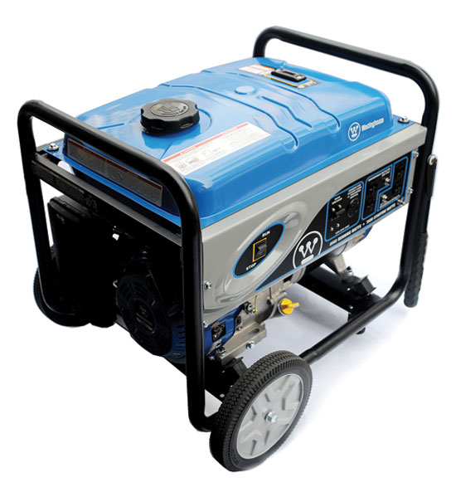
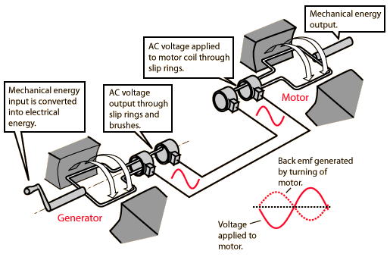
Motor and Generator Comparison
.moving charges experience a force that is perpendicular to both their motion and the magnetic field they traverse.
.We will call the deflected wire the motor effect and the law of induction the generator effect. Each of these effects is summarized in the figure.

Slide 5
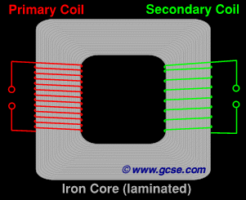
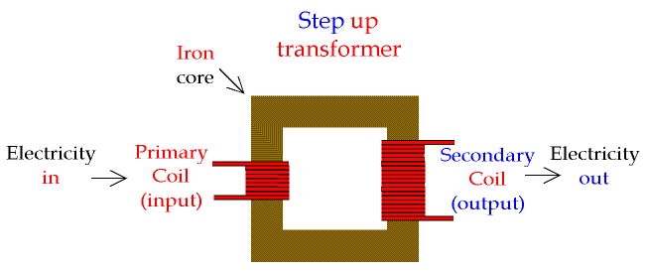
Transformers
Consider a pair of coils, side by side, as shown.one is connected the battery and the other is connected to the galvanometer.
It is customary to refer to the coil connected to the power source as the primary (input), and the other as the secondary(output).
Instead of opening and closing a switch to produce the change of magnetic field, suppose that alternating current is used to power the primary. Then the rate at which the magnetic field changes in the primary(and hence in the secondary) is equal to the frequency of the alternating current. Which means we have a transformer

Slide 6
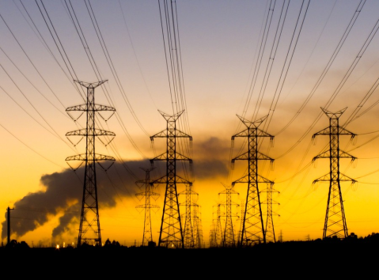
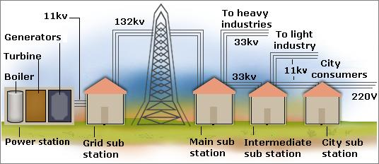
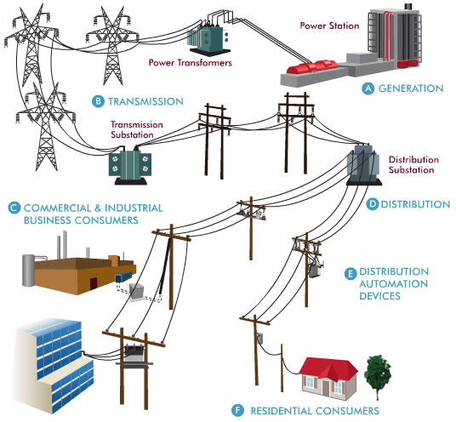
Power Transmission
Almost all electric energy sold today is in the form of alternating current because of the ease with which it can be transformed from one voltage to another.
Power is transmitted great distances at high voltages and correspondingly low currents, a process that otherwise would result in large energy losses owing to the heating of the wires.
Power may be carried from power plants to cities at about 120 000 volts or more, stepped down to about 2200 volts in the city , and finally stepped down again to provide the 120 volts used in household circuits.

Slide 7
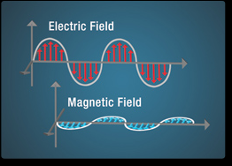
Induction of Electric and Magnetic Fields
Electromagnetic induction has thus far been discussed in terms of productions of voltages and currents. Actually the more fundamental way to look at it is in terms of the induction of electric fields. The electric fields, in turn, give rise to voltages and currents. Induction takes place whether or not a conducting wire or any material medium is present.
A magnetic field is created in any region of space in which an electric field is changing with time. The magnitude of the created magnetic field is proportional to the rate at which the electric field changes.

Slide 8
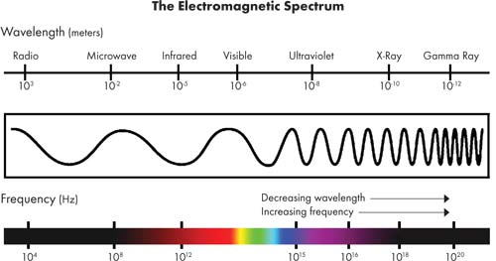
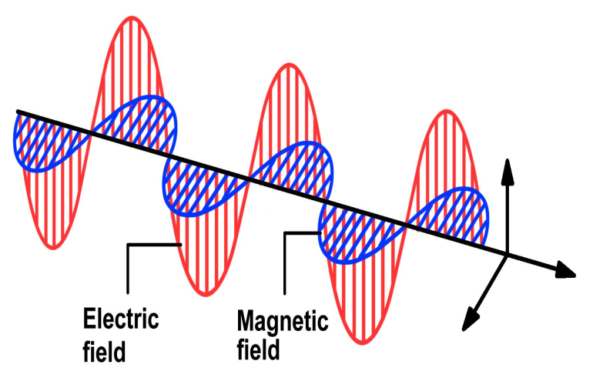
Electromagnetic Waves
.Electromagnetic wave is composed of vibrating electric and magnetic fields that regenerate each other. No medium is required.
.The vibrating fields emanate from the vibrating charge. At any point oh the wave, the electric field is perpendicular to the magnetic field, and both are perpendicular to the direction of motion of the wave.
Electromagnetic wave do not need a medium to travel through
Example: X-ray, Light, Radio
Mechanical waves need a medium to travel
Example: Water, Sound, Seismic

